Slide 1
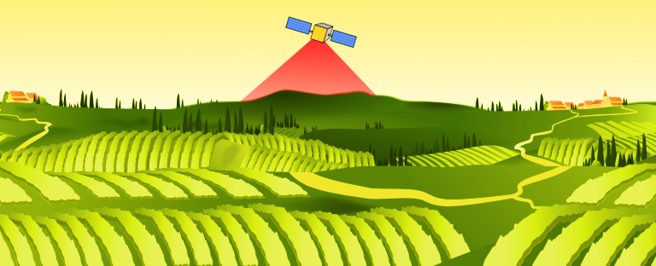

AGROGIS
Subject : Open Source GIS
Prepared by: Manuel Robledo Ábalos & Florence Sarmah

Slide 2


Agenda
Problem Statement
Solution and Technical Architecture
Concept & Objecives
Project Roadmap

Slide 3
What is our Problem Statement ?
Challenge 1
Limited digital tools for effective plot management.
Challenge 2
Inefficient resource allocation due to poor data visualization.
Challenge 3
Lack of real-time information on weather and soil health impacting decision-making.
The Challenge in Agriculture:

Slide 4
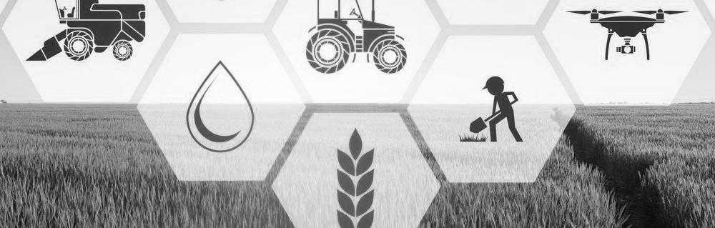
General Objective:
Develop a SaaS to efficiently manage agricultural plots using GIS technologies, data analysis, and environmental monitoring.
AGROGIS Project Overview:
AGROGIS is a Software as a Service (SaaS) solution designed for the agricultural sector.
Aims to digitize and optimize management of agricultural plots using Geographic Information System (GIS) tools and data analysis.
Provides a platform for users to register properties and visualize plots through an interactive map.

Slide 5
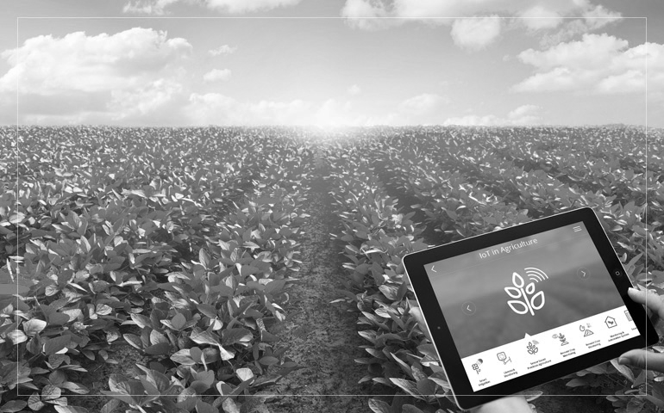
Plot Management:
Geospatial Visualization:
Register and manage detailed information about plots, including crop type and size.
Implement an interactive GIS viewer for plots.
Concept & Objectives
Accessibility & Scalability:
Climatic and Satellite Data Integration:
Provide real-time data through dashboards and calculate indices like NDVI and NDWI.
Make AGROGIS accessible on any device with scalable functionalities.
.

Slide 6
Plot management
Interactive GIS Map
Real-time Dashboards
Satellite Image Analysis
Use Case 1
Use Case 2
Use Case 3
Use Case 4
Digitizes plot management, enabling farmers to easily track and manage plot characteristics such as crop type, size, and current condition.
Allows visualization of georeferenced information, where farmers can click on plots to access detailed data.
Integrates data on temperature, humidity, and precipitation, supporting data-driven decisions.
Uses NDVI and NDWI to provide insights about crop quality and water avaibility.

Slide 7
Technical Architecture of AGROGIS
Infrastructure: | Tools and Technologies:
Backend: Django with GIS extensions to handle geospatial data. | Docker for infrastructure, managing GeoServer, PostGIS, and pgAdmin services.
Frontend: OpenLayers for interactive map visualization. | PostGIS for spatial data management.
Data Processing & Analysis: Using satellite data from Copernicus and Sentinel-2. | Sentinel Hub and Python for spectral analysis.

Slide 8






PROJECT ROADMAP
Before christmas
After christmas
2
4
Week 1-2
Week 5-6
1
3
5
Week 7
Backend setup with GIS support (Django, PostGIS).
Develop real-time climatic data integration for dashboards and satellite data integration.
Week 3-4
Infrastructure deployment using Docker (GeoServer, PostGIS, pgAdmin).
Frontend: Basic interactive map for plot visualization using OpenLayers.
Final adjustment…

Slide 9
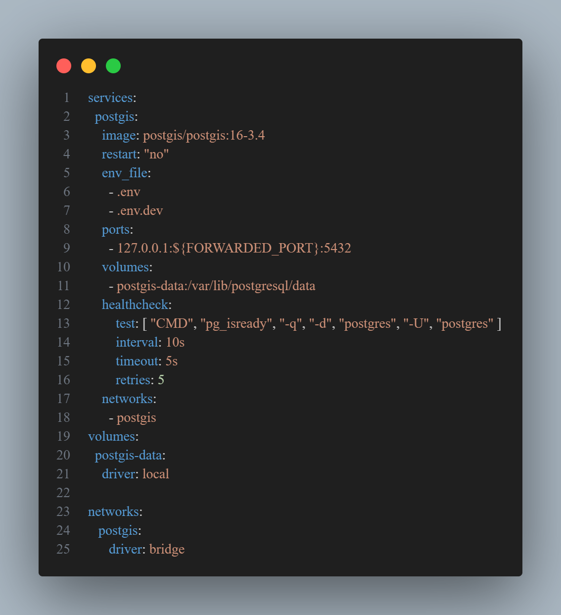
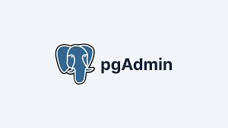
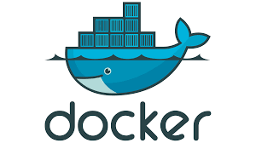
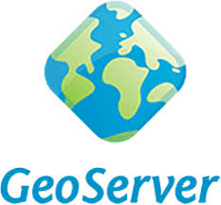
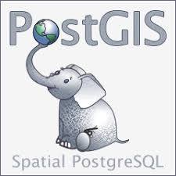
METHODOLOGY
System Design:
Infrastructure setup using Docker (GeoServer, PostGIS, pgAdmin).
Database creation with PostGIS for spatial data.

Slide 10

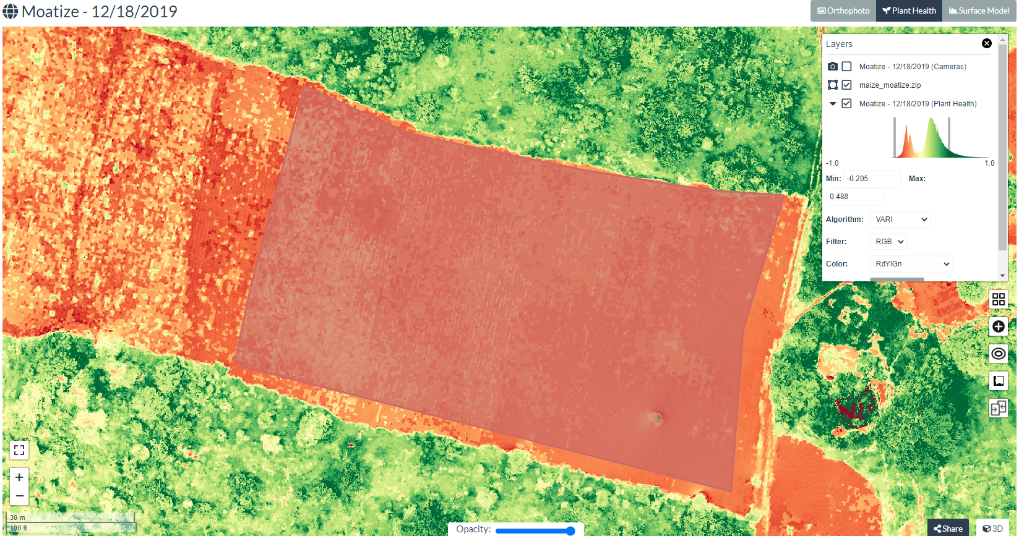

METHODOLOGY
Development:
Backend: APIs for parcel management and data integration (Django with GIS extension).
Frontend: Interactive map viewer (OpenLayers) and dashboards.

Slide 11
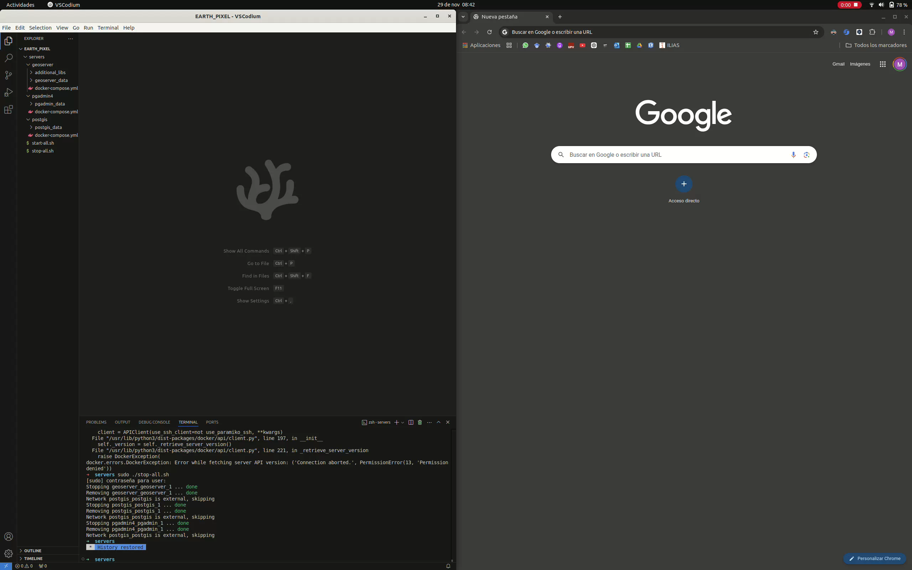
METHODOLOGY

Slide 12
Thanks a lot for your attention!
Do you have any questions?

